Slide 1
Welcome
We are so glad you’re here.

Slide 2
Today’s Agenda
Welcome
Core Agreements
Brief Presentation
Group Discussion: Across Generations
Guest Speaker: Julia Campbell
Celebration!
Notes:
Today’s session will kick off by each of you briefly introducing yourselves by sharing the picture you created in the pre-work so we can all get a sense as to how we are arriving to this coursework together. Then we will discuss core agreements to make this a safe space and to ensure we all treat each other with respect and dignity as we move through this process. After that, I’ll tell you about the buddy system and breakout groups, then we will dive into our presentation today- this will set the stage for you to head into tur first breakout group – connect and then we will come back together to share before I fill you in on your next homework assignment.

Slide 3
Core Agreements
Treat others as they would like to be treated.
Hold our judgments lightly.
Do not assume others’ identities.
Make space. Take space.
Commit to unlearning: You’re allowed to grow and think things you didn’t used to.
Commit to not requiring there always be an answer.
Use the Ouch/Oops Method to signal harm has been done and accept responsibility.
Main room sessions will be recorded yet coaching and breakout groups will be private sessions. What stays in the breakout groups, stays there.
Respect the level of detail people choose to disclose about their fundraising.
Collaborate whenever possible, do not compete.
Notes:
Ok, great. Thank you all. Let’s chat core agreements. If you want you can give me a

Slide 4
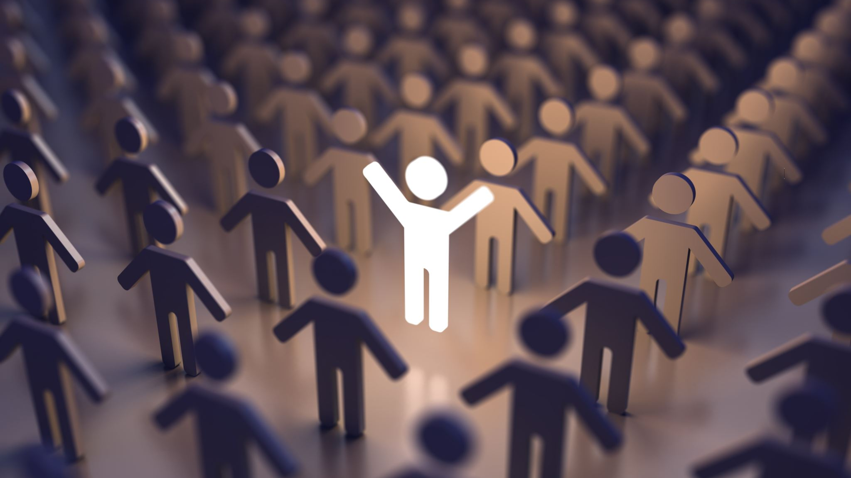
Simple Ways to Ensure Effective Intergenerational Collaboration
• Be intentional. • Have a plan to resolve conflicts. • Give every generation a role. • Celebrate diversity. • Engage other generations in the design process. • Think about the #mentorshipmoments. • Keep negativity away. • Share stories. Often. • Seek outside opportunities.

Slide 5
Celebration! November 11th 4pm EST

